Slide 1
WD-40 ADVERT
By Gabriel Hunter & Daniel Arkell

Slide 2
Initial Idea
Advertising WD-40 and duct tape together in a style of a combo pack. However it was decided that we should only concentrate on one. This is because stores would only usually do it for promotional purposes, for example Screwfix.
The advert would consist of a male using WD-40 to fix any problems he encounters on his daily routine in the morning. We wanted to add in comedy elements to appeal to a larger audience if it was shown on television. We decided that using WD-40 as deodorant had comedic value.

Slide 3
Our idea
Our idea is to attempt to portray WD40 with its many uses but with a added comedic value. We did this by having our protagonist use the WD40 as deodorant and having it seen almost everywhere around the house, But also included its intended uses by having him use it to loosen up a door lock and also a cupboard door hinge.

Slide 4
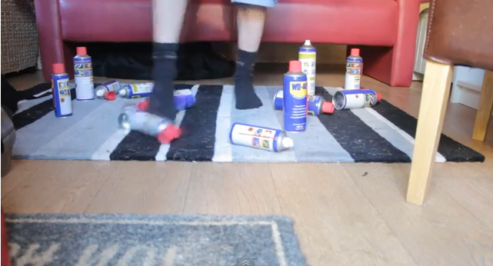
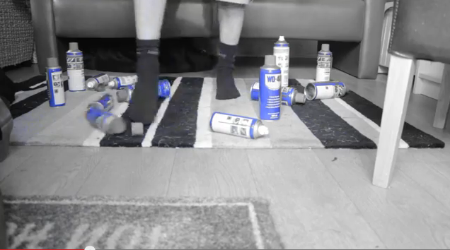
Development
In the first cut we kept all the colours, this made it realistic although we found that the second cut emphasized on the can which is the idea of the video.
First Cut
Final Cut

Slide 5
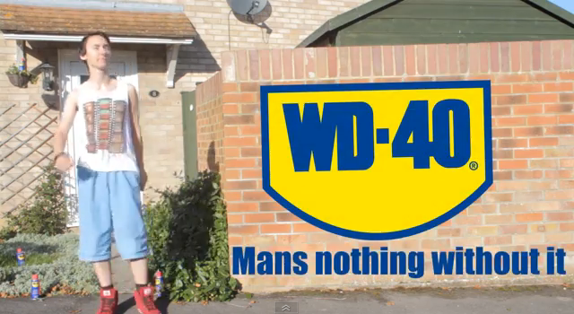
Development
After realising that we had made a grammar error on the last shot, we quickly corrected it.
First Cut
Final Cut

Slide 6
Development
The main developments for our advert was generally making it shorter to fit the 30 second limit. This was a struggle because we had to remove a scene that we both really like and some of the scenes were key to the continuity and anecdotal theme of our advert. In essence we wanted our ad to portray the morning routine of our protagonist.

Slide 7
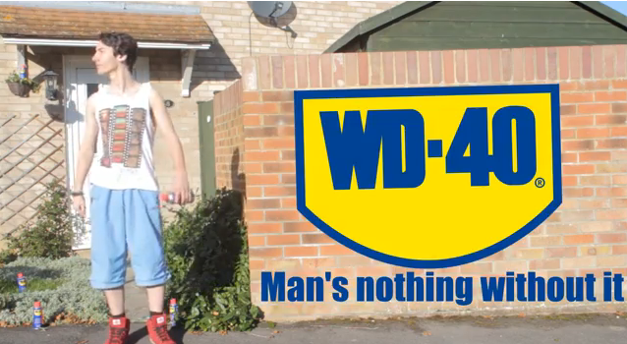
Feedback
The feedback that we have received has been mostly positive, with very helpful constructive criticism. We have to use as many of the ideas that our group has gave us.
-‘Lots of research and information’
-‘Tighter editing’ (referring to our first cut)
-‘I like the use of the wall for the last shot’
-‘Great music choice and product placement’
-‘Enjoyable, didn’t know what WD-40 did until now’

Slide 8
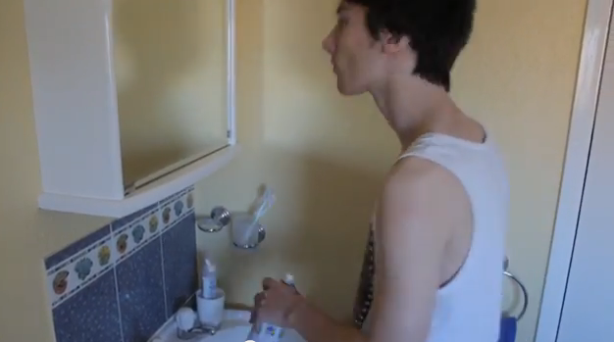
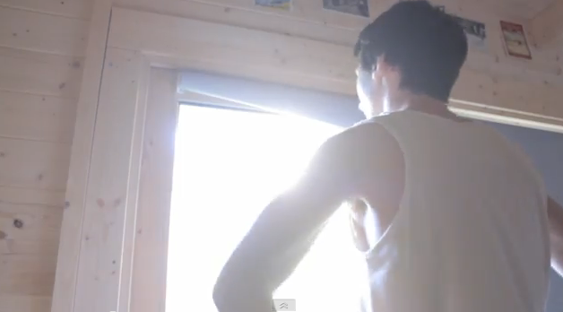
Challenges
Filming in the Bathroom: We had problems filming in the bathroom because there wasn’t a lot of room and Dan had to stand in the bath tub. Instead of setting up a tripod Dan held the camera still.
Moving the cans: It got quite vigorous moving the cans to each room, but we had a box to easily move the cans up and down stairs.
The lighting became a problem on some shoots, this was easily solved by opening or closing curtains.

Slide 9
Challenges cont.
Another can related challenge was the placing of cans. We wanted to make sure there was a equal line between a disorganized mess, and not spreading the cans too sparsely as we only had around 14 cans which in some wider shots still wasn’t quite enough.

Slide 10
Evaluation
We are both very pleased with the outcome. We both worked well together and made everything in good time. We tried to use all of the ideas given by fellow class mates and it was a great help having fresh eyes look at our work and telling us any improvements etc.
To improve we could try and get more WD-40 cans and also work on quicker cuts. We could also possibly work on the set up of the scene, possibly adding in little things in the background like duct tape and other things you could associate with a DIY man.

Slide 11
Final Video
http://www.youtube.com/watch?v=7bz2IkdKtPk

Slide 12
Final Video
After many different changes this advert has gone through, we have finally came to our final cut. The improvements we have made are only small but we believe that we are advertising WD-40 a lot more in the final cut. For example we have extended the last shot of Gabriel walking out of his front door with the WD-40 logo coming up, this shows the audience what it looks like for a longer period of time. We have also extended the third shot where Gabriel is walking past the cans. This indicates to the audience how much WD-40 is in his life.

