Slide 1
WD40
Dan & Gabriel

Slide 2
Initial idea
Advertising WD40 and duct tape in a style of combo pack, however it was decided as these are 2 separate companies it wouldn’t be likely the 2 would advertise together unless it was a promotional item in a magazine such as Screwfix.
The advert would consist of a male using WD40 to fix almost anything, but also using as everyday toiletries such as deodorant, aftershave etc. but also using it for its intended uses such as rusted/creaking moving parts (hinges, chains)

Slide 3
Various suggestions
After our first pitch a few suggestions were made about our initial pitch.
1. Changing the combo pack to just focus solely on one product which we decided to be WD40
2. Another idea for the advert was instead of it being used by a very “manly” man, have him struggle with something mechanical then a smaller lesser built man comes along and solves it with just WD40, “Anyone can fix something”.

Slide 4
Decided idea
Sticking with WD40 only.
As WD40 is such a recognized product as a lubricant and water displacer the advert could focus more around its 1000’s of uses rather than the product itself such as our intended manly ad but with a slogan such as “but did you know…. It also…-”
Viral advert for WD40
http://vimeo.com/28047804

Slide 5
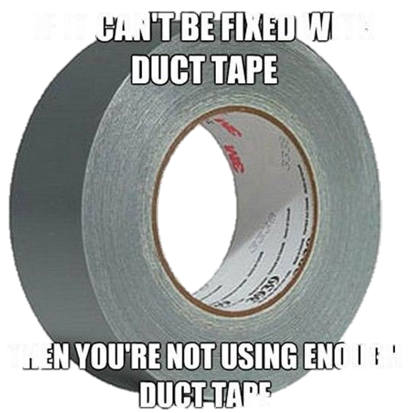
Side idea
Advert for Duct tape:
Couple sat on the sofa and male is trying to watch TV but female is constantly talking, as male struggles to fight with his partner talking and the tv volume. He then looks over to the coffee table with a roll of duct tape on and begins thinking as he picks it up and rolls some tape out. Cut to male blissfully watching tv and partner is quiet, pan out to reveal his partner has duct tape across her mouth and he has a smug face.
“Silence is golden. Duct tape is silver.”

